Slide 1
IronKaggle
June 2022 COHORT
One Day Challenge

Slide 2
What is an IronKaggle?
An IronKaggle is a one day challenge event where you will use your analytical and technical skills to tackle a given problem.

Slide 3
WHY ARE WE DOING THIS??

Slide 4
GOALS
Datathon = Mini ML project.
Challenge yourself.
Great learning opportunity.
Learn from team mates.
Have a great time!

Slide 5
CHALLENGE

Slide 6
Ironhack Market wants to expand the business
They want to know the revenue of each store each day in order to decide their future steps as a company.
They hire you as a Data Analyst

Slide 7
The objective is to analyse or predict the revenue of the shops in each day.

Slide 8
THE PLAN
10.30 h sales.csv
~ 640000 rows - label included
16.00 h validation_for_students.csv
~ 71200 rows - label excluded
16.30 h Predictions delivery
17.00 h Winner announcement

Slide 9
THE PLAN
10.30 h sales.csv
~ 640.000 rows - label included
15.30 h validation_for_students.csv
~ 71.200 rows - label excluded
16.30 h Predictions delivery
17.00 h Winner announcement

Slide 10
THE PLAN
10.30 h sales.csv
~ 640.000 rows - label included
15.30 h validation_for_students.csv
~ 71.200 rows - label excluded
16.30 h Predictions delivery
17.00 h Winner announcement

Slide 11
THE PLAN
10.30 h sales.csv
~ 640.000 rows - label included
15.30 h validation_for_students.csv
~ 71.200 rows - label excluded
16.30 h Predictions delivery
17.00 h Winner announcement

Slide 12
EVALUATION ON THE VALIDATION SET
You must send you predictions as a csv file directly to Jan via Slack.
The models will be evaluated using RMSE.
You can submit up to 3 prediction arrays. We will keep your best score (indicate which is your favourite one in the name)

Slide 13
EVALUATION ON THE VALIDATION SET
You must send you predictions as a csv file directly to Jan via Slack.
The models will be evaluated using RMSE.
You can submit up to 3 prediction files. We will keep your best score (indicated which is your favourite one in the name)
True_index | Sales
... | ...
... | ...

Slide 14
LAST TIPS & TRICKS!
Deliver on time!
Learn from each other.
Splitting the work is OK.
You’re stronger together.
WORK FAST, HAVE FUN!

Slide 16
TEAMS:

Slide 17
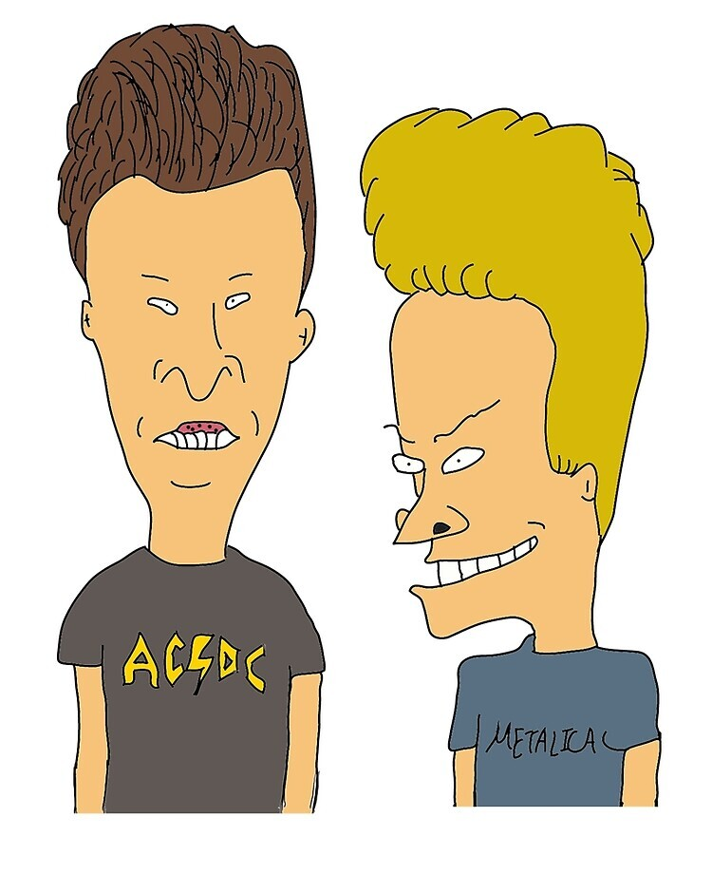
Beavis & Butt-Head
Ferreira
Martin

Slide 18
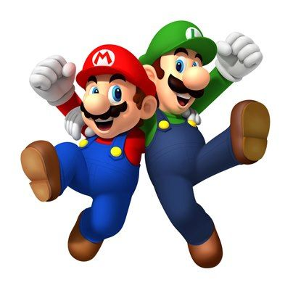
Mario & Luigi
Osher
Chris

Slide 19
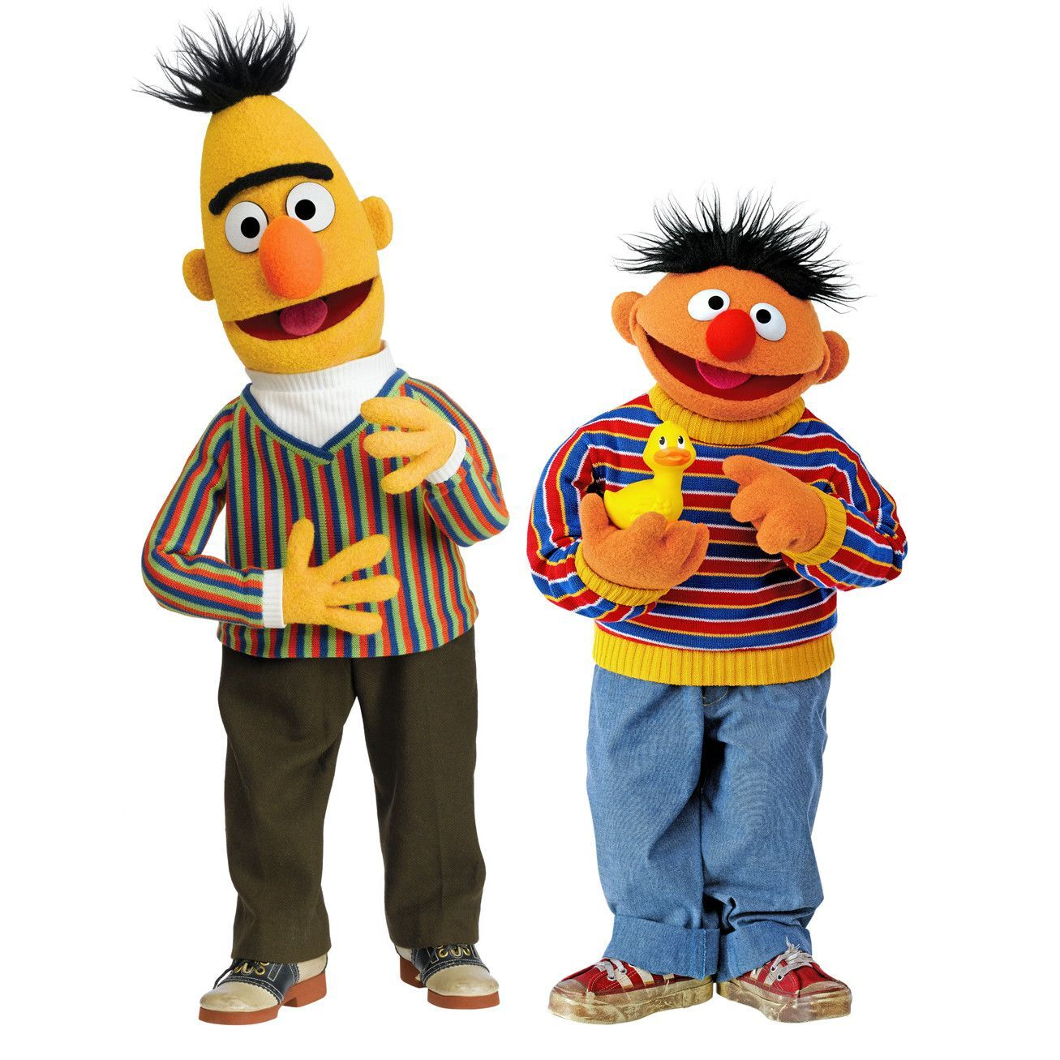
Bert & Ernie
Elen
Philip

Slide 20
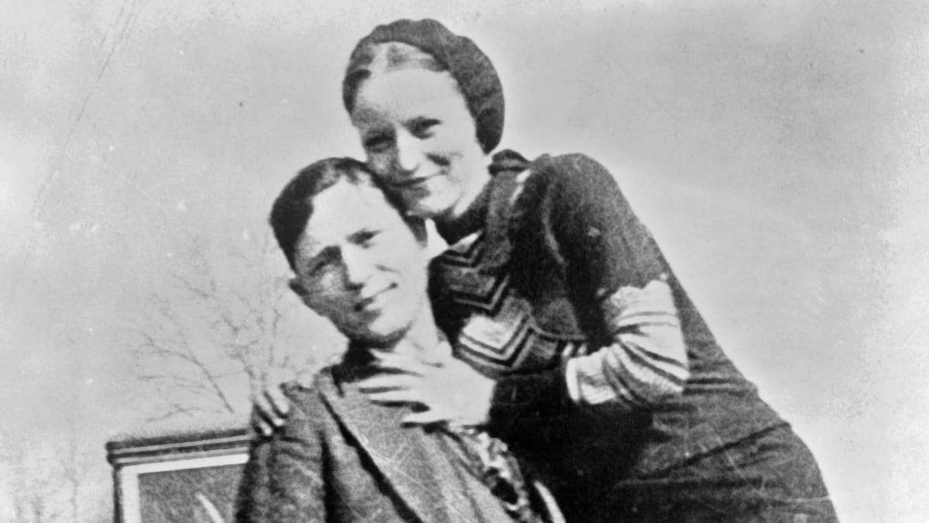
Bonny & Clyde
Jose Maria
Holly

Slide 21
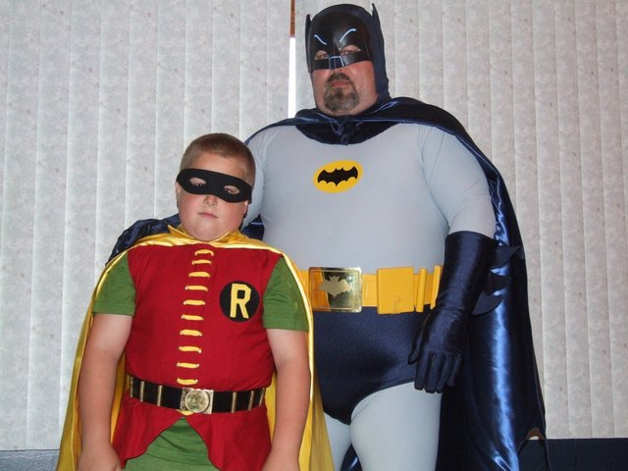
Batman & Robin
Pedro
Rebecca

